Slide 1

Audit Fraud Risk
Samuel Chadick, Rebeca Duron, Samantha Friday, Elizabeth Monks, Adam Rodriguez, Jessica Rodriguez, Sachi Wijeratne

Slide 2


PROBLEM STATEMENT
Current audit processes lack effective tools for firm classification based on historical risk factors, impacting accuracy. Implementing automated logistic regression enhances fraud detection, bolstering financial audit reliability.
ADDRESSING THE PROBLEM
Mitigating audit risk is pivotal for audit agencies, aligning with strategic objectives. Equipping auditors with machine learning models optimizes resource allocation, precisely forecasting high-risk cases for a more focused and efficient audit approach.

Slide 3
9 0 8 7 0 1 0 0 0 8 7 6 0 9 0 0 3 0 4 5
0 7 0 0 1 2 9 8 7 6 5 4 6
0 8 0 0 1 0 4
9 2 1 1 6
4 0
0
2 6
8
0
1
1 4 0 2 0 7 0 1 0 5 0 1
9 3 0 1 0 0 0 8 0 1 0 5
1 1 0 2 0 1 0 3 0 1 0 4 4 1 0 5
0 1 0 6 0 1 0 0 9 0 1 0 7 0 7 8 0 1 0 8
0 2 0 3 0 7 0 2 1 0 1 0
4 6 5
6
0
DATA OVERVIEW
Dataset consists of 10 rows and 776 columns, capturing financial metrics and risk scores for government firms in India.
DATA DICTIONARY
DISTRICT_SCORE: RISK SCORE OF A DISTRICT IN THE LAST 10YEARS
HISTORY: FIRMS’ AVERAGE HISTORICAL LOSS IN THE LAST 10 YEARS
MONEY_VALUE: AUDIT MISSTATEMENT AMOUNT
NUMBER: HISTORICAL DISCREPANCY SCORE
PARA_A: EXPENDITURE DISCREPANCY
PARA_B: EXPENDITURE DISCREPANCY
RISK FLAG: 1 = FRAUD, 0 = NO FRAUD RISK
0
2
0 1
2 0 5
0 1 0 6
0 2 0 0 0
5 0 2 4 0 0 6 0
0 0 0 9 2 0 6 8 0 1 9 0

Slide 4

Data Visualization

Slide 5
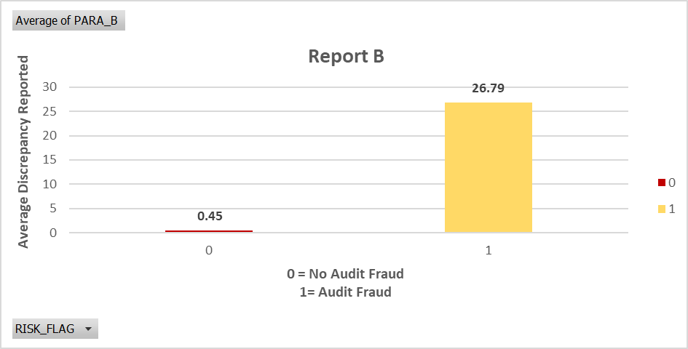
Financial Discrepancies in Planned Expenditure and Report B (Rs in Crore)
Para_B Average (Audit Fraud Risk 0):
Discrepancy in planned expenditure: Rs (in crore) with an average score of 0.45
Para_B Average (Audit Fraud Risk 1):
Discrepancy in planned expenditure: Rs (in crore) with an average score of 26.79.
Inference:
Report B suggests a considerably higher audit fraud risk (1) compared to the case with a fraud risk of 0, evident in the significant difference in average scores.

Slide 6
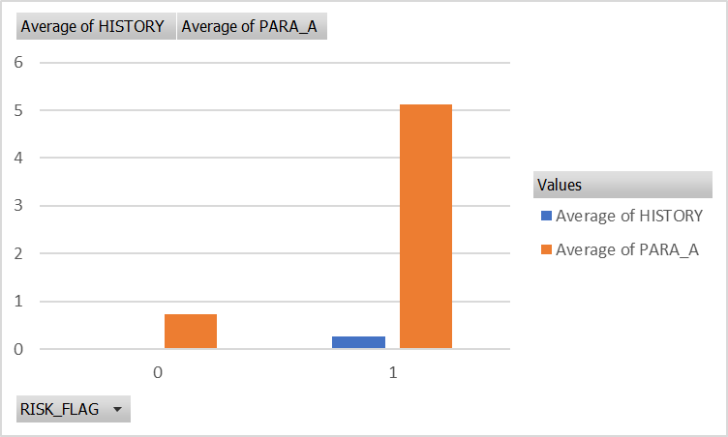
PARA-A BEHAVIOR AND 10 YEAR HISTORICAL RISK SCORE TRENDS IN COMPARISON WITH RISK STATUS CLASSES FOR A DISTRICT
Similar Pattern in Para A and Para B
When risk flag is O
Both Para A and Para B exhibit lower scores.
When the risk flag is 1
Both Para A and Para B show higher scores.
This indicates a consistent pattern: Para A and Para B have a similar level of discrepancy corresponding to the risk flag.

Slide 7
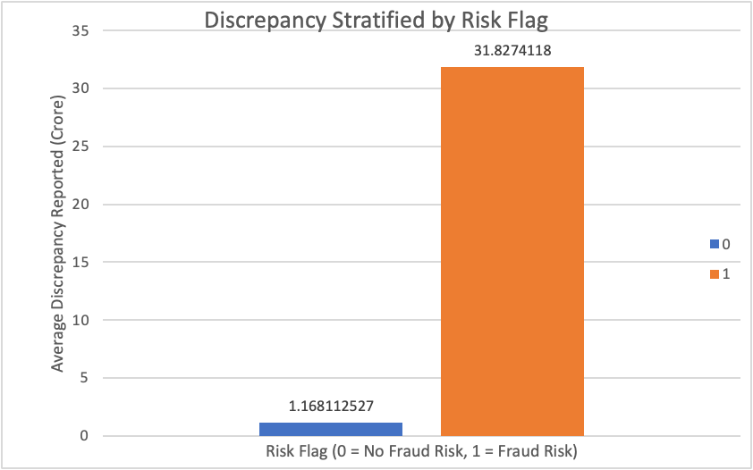
COMPARING PARA_A AND PARA_B FOR FRAUD RISK FLAGGED VS. NON-FLAGGED RECORDS
Data Categories
Records flagged as fraud risk.
Records not flagged as fraud risk.
Observation
Average discrepancy for flagged firms for 30 times higher compared to non-flagged firms
Implication
The visualization highlights a significant disparity in discrepancy levels between firms flagged for fraud risk and those not flagged.

Slide 8
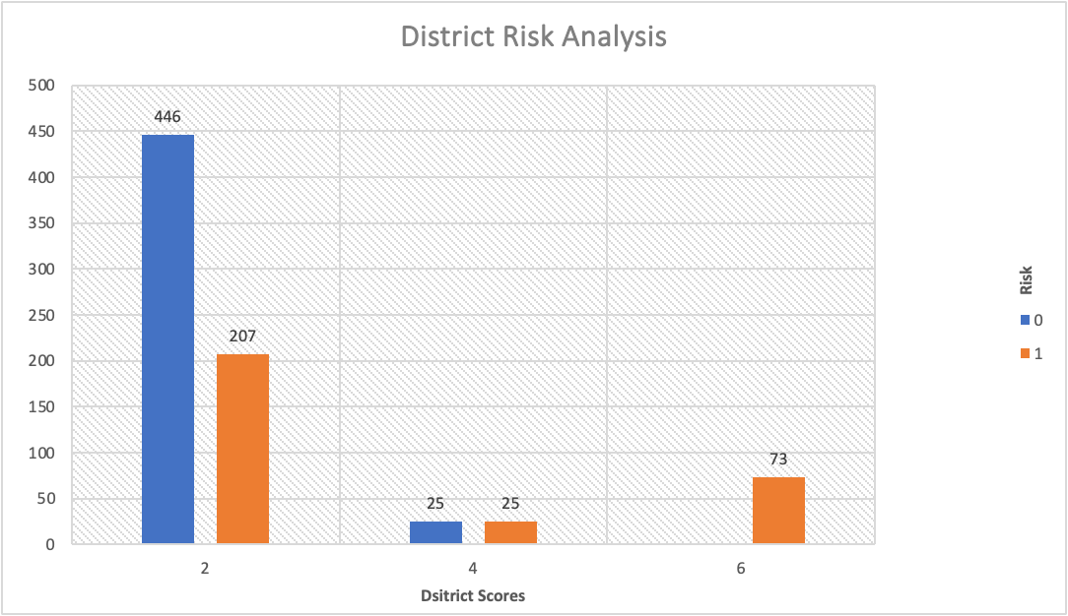
District Risk Analysis
Data Categories:
3 district scores of 2,4,6
Each score has numbers of cases
Description:
District 2: higher incidence of audit fraud risk
District Score 4 appears to have an equal distribution between audit fraud risk and no audit fraud risk.
A District Score of 6 and no information provided for Risk Flag.
Insights:
Specific district scores may indeed relate to the risk flag, with some districts having a higher likelihood of audit fraud risk (Risk Flag 1), while others have a more balanced distribution or incomplete information.

Slide 9
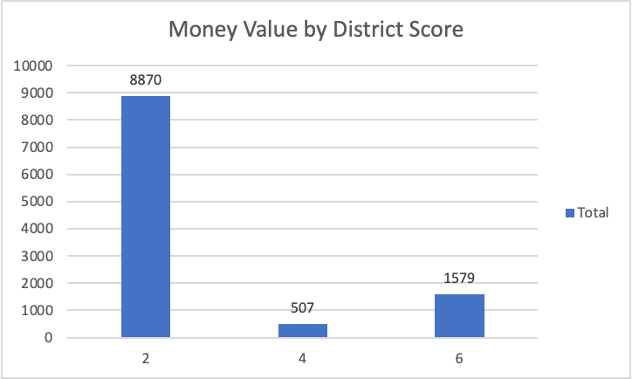
Money Value by District Score
District Score 2:
Historical Risk Score: Moderate
Money Value: 8,870 Rupees
Implication: Substantial money in misstatements, suggesting potential financial discrepancies.
District Score 4:
Historical Risk Score: Higher
Money Value: 507 Rupees
Implication: Despite a higher risk score, the money involved in misstatements is relatively low.
District Score 6:
Historical Risk Score: Intermediate
Money Value: 1,579 Rupees
Implication: Falls between others, indicating moderate historical risk and a moderate amount of money in misstatements.
Notes:
Jess

Slide 10

DATA MODELING

Slide 11
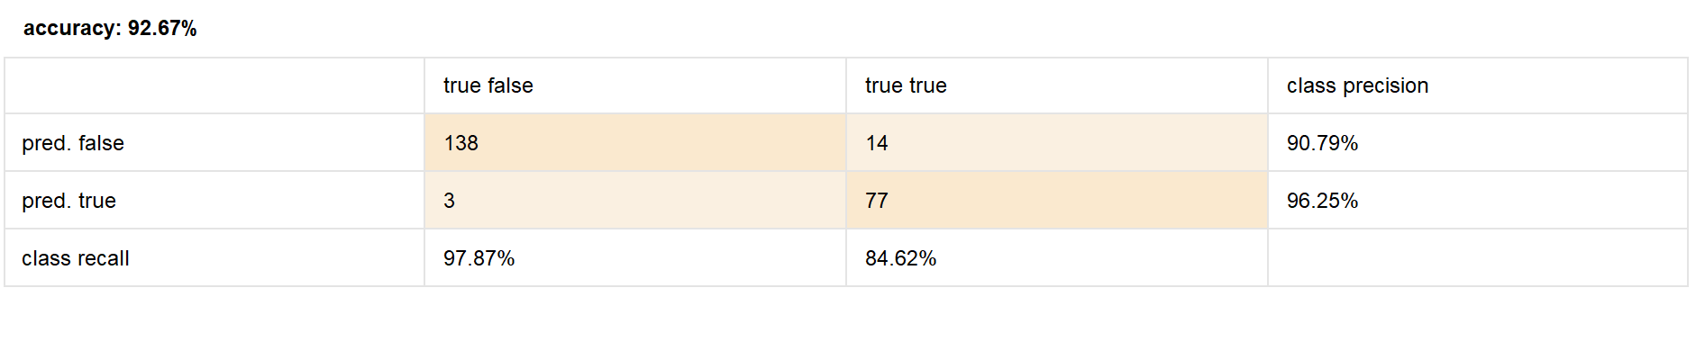
K-NEAREST NEIGHBORS CLASSIFICATION MODEL EVALUATION
Model Selection: Chose k-nearest neighbors for predicting fraud risk.
Optimal k-Value:
Determined optimal k-value through trial-and-error.
Selected k = 5 for the model.
Performance Metrics:
Accuracy Score: 92.87%
Recall Score: 84.62%
AUC Score: 0.957
Model Comparison: Among three models created, k-NN performed the poorest.
Notes:
Jess

Slide 12
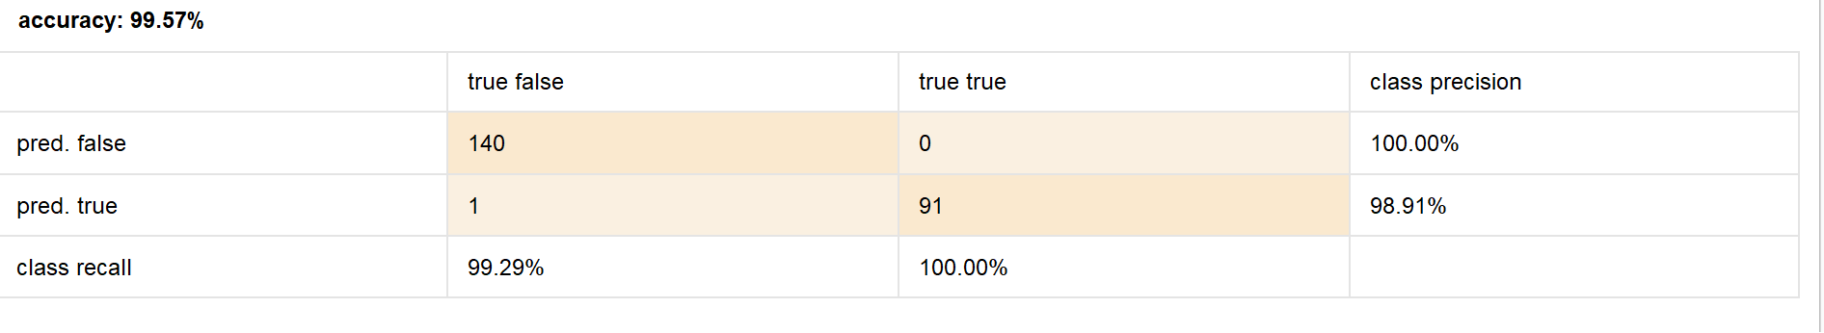
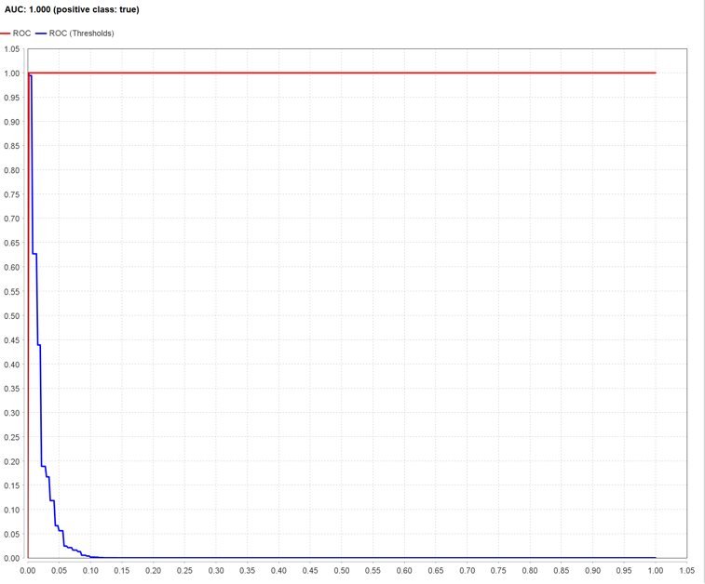
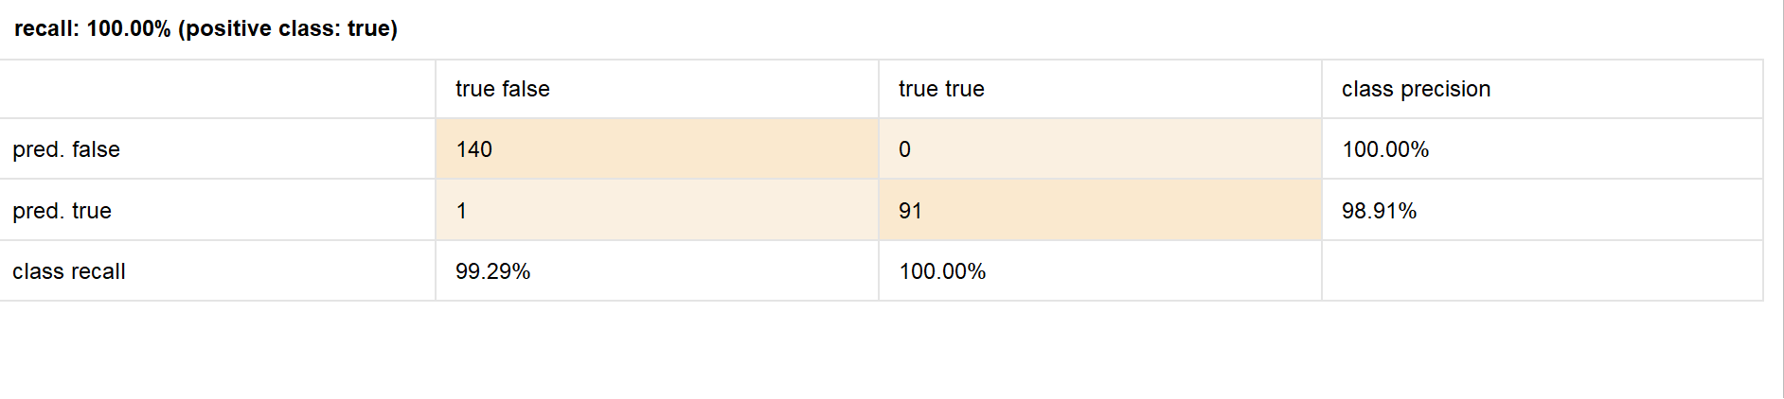
LOGISTIC REGRESSION MODEL: SUPERIOR PERFORMANCE IN FRUAD RISK PREDICTION
Model Selection: Chose logistic regression for binary target variable.
Performance Metrics:
Accuracy: 99.57%
Recall: 100.00%
AUC: 1.000
Confusion Matrix: Only one error: false positive for fraud risk.
Summary: Logistic regression excelled in predicting fraud risk classes.

Slide 13
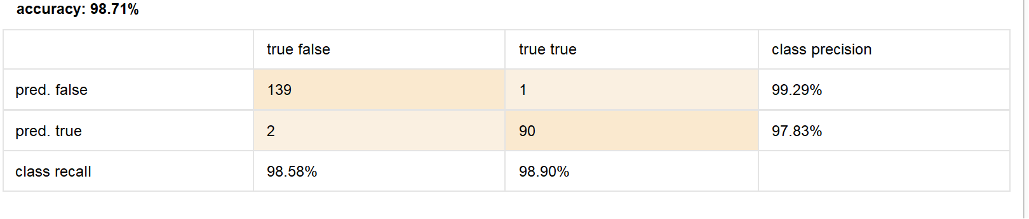
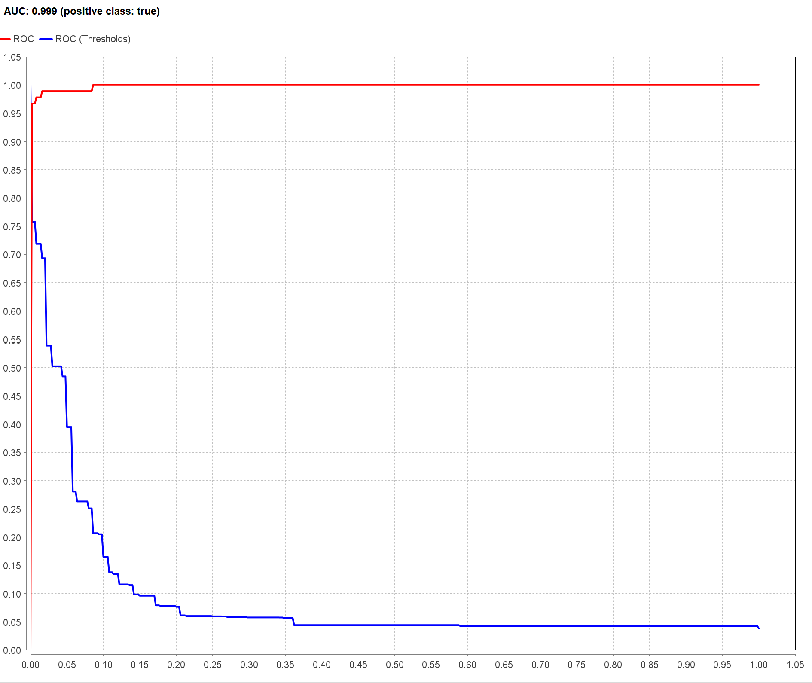
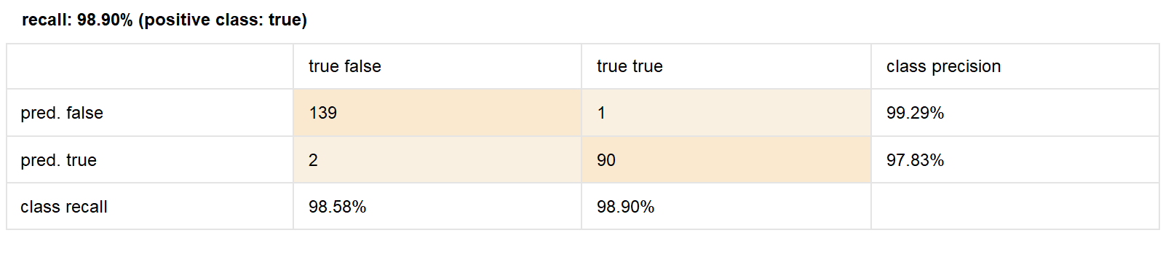
RANDOM FOREST MODEL: ROPBUST CLASSIFICATION PERFORMANCE
Model Selection: Chose random forest for superior classification over single decision trees.
Tuning: Optimal model achieved through trial-and-error.
Criteria: Accuracy
Number of Trees: 50
Performance Metrics:
Accuracy: 98.71%
Recall: 98.90%
AUC: 0.999
Comparison: Outperformed k-NN, slightly below logistic regression.

Slide 14

Conclusion
Objective: Optimize auditor time for fraud risk assessment.
Key indicators: district/sector scores, spending discrepancies, and large missed statement values.
Best Model: Logistic regression excelled in accuracy, recall, and AUC.
Recommendation: Implement logistic regression for efficient fraud risk predictions.
Outcome: Streamline auditing with a data-driven approach, focusing on identified risk factors.

Slide 15

Thank you...

